Slide 1


Introduction to Python
September / 2016
Corporate Presentation Template | © 2016, Abzooba India Infotech Pvt. Ltd.

Slide 2

Overview
Introduction
Set up Python on machine
Development Environments
Hello World
Indentation
Comments/Docstrings
Data Structures
Python Iteration
Conditional Constructs
Functions
Python Generators
Classes
Error Handling
Python Libraries
List of Useful Python Libraries
Library/Package Management
Corporate Presentation Template | © 2016, Abzooba India Infotech Pvt. Ltd.

Slide 3
Introduction
Why should I learn Python?
Open Source – free to install
Awesome Online Community
Easy to learn
Becoming a common language for data science and production of web based analytics products
Object Oriented Scripting language (Best of R and Java)
Drawbacks:
Python is an interpreted language rather than compiled language – hence might take up more CPU time. However, given the savings in programmer time (due to ease of learning), it might still be a good choice.
Corporate Presentation Template | © 2016, Abzooba India Infotech Pvt. Ltd.

Slide 4
Setting up Python on machine
Python 2.7 v/s 3.4:
Python 2.7 has a plethora of third-party libraries. Though many libraries have provided 3.x support but still a large number of modules work only on 2.x versions. Better to start with Python 2.7
Python 2.7 is the last release for the 2.x family and eventually everyone has to shift to 3.x versions.
Installing Python of your choice:
You can download Python directly from its project site and install individual components and libraries you want
Alternately, you can download and install a package, which comes with pre-installed libraries.
Second method provides a hassle free installation and hence I’ll recommend that to beginners.
Corporate Presentation Template | © 2016, Abzooba India Infotech Pvt. Ltd.

Slide 5
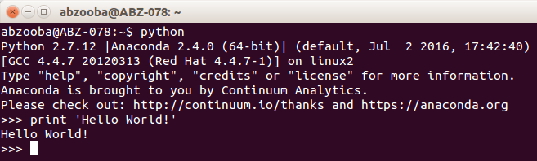


Development Environments
Terminal / Shell based
iPython notebook – similar to markdown in R
IDLE (default environment) – PyCharm & Spyder
Corporate Presentation Template | © 2016, Abzooba India Infotech Pvt. Ltd.

Slide 6

Hello World
hello_world.py
Corporate Presentation Template | © 2016, Abzooba India Infotech Pvt. Ltd.

Slide 7
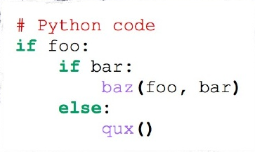
Indentation
Most languages don’t care about indentation
Most humans do; we tend to group similar things together
Python embraces indentation:
No semi colon at the end of the line like in some other programming languages
Corporate Presentation Template | © 2016, Abzooba India Infotech Pvt. Ltd.

Slide 8
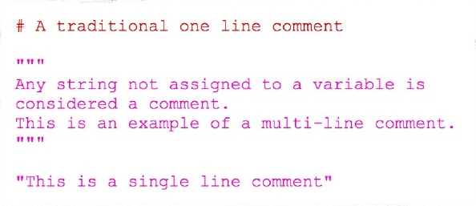
Comments/Docstrings
Adding comments for small code snippets is a very good programming practice
Its very easy to add comments in Python:
Corporate Presentation Template | © 2016, Abzooba India Infotech Pvt. Ltd.

Slide 9
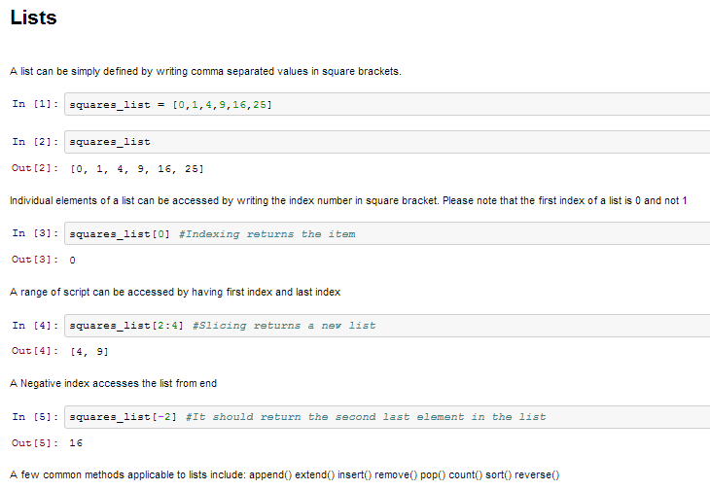
Data Structures: Lists
List of comma separated values in square brackets
Lists might contain items of different types
One of the most versatile data structure in Python
Python lists are mutable and individual elements of a list can be changed
append(), extend(), remove(), pop(), count(), sort(), reverse()
Corporate Presentation Template | © 2016, Abzooba India Infotech Pvt. Ltd.

Slide 10
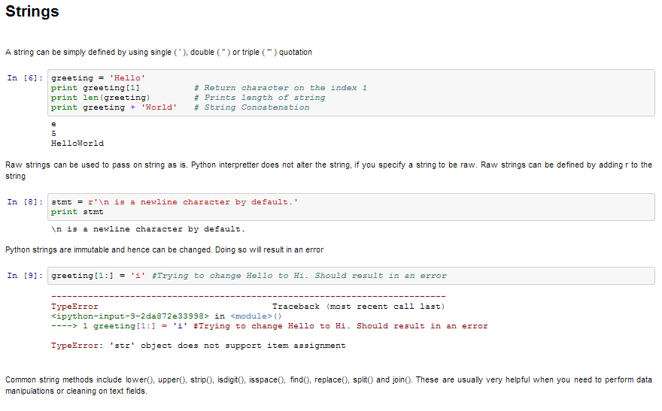
Data Structures: Strings
Strings can simply be defined by use of single ( ‘ ), double ( ” ) or triple ( ”’ ) inverted commas
Strings enclosed in tripe quotes ( ”’ ) can span over multiple lines and are used frequently in docstrings
\ is used as an escape character
Python strings are immutable
Corporate Presentation Template | © 2016, Abzooba India Infotech Pvt. Ltd.

Slide 11
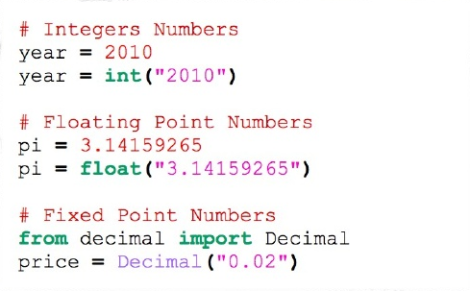

Data Structures: Numbers & Null
Integers
Floating Point Numbers
Fixed Point Numbers
Null
Corporate Presentation Template | © 2016, Abzooba India Infotech Pvt. Ltd.

Slide 12
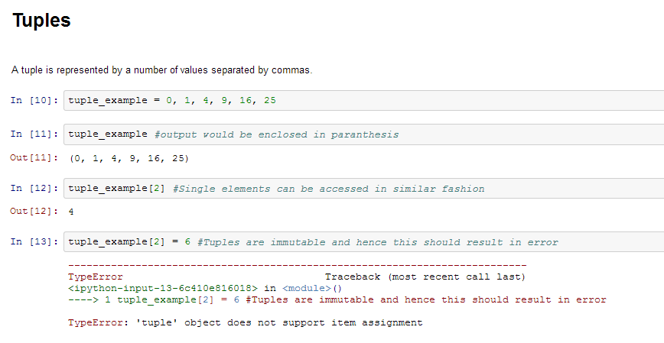
Data Structures: Tuples
A tuple is represented by a number of values separated by commas
Tuples are immutable and the output is surrounded by parentheses so that nested tuples are processed correctly
Even though tuples are immutable, they can hold mutable data if needed
Tuples, since immutable are faster in processing as compared to lists
Corporate Presentation Template | © 2016, Abzooba India Infotech Pvt. Ltd.

Slide 13
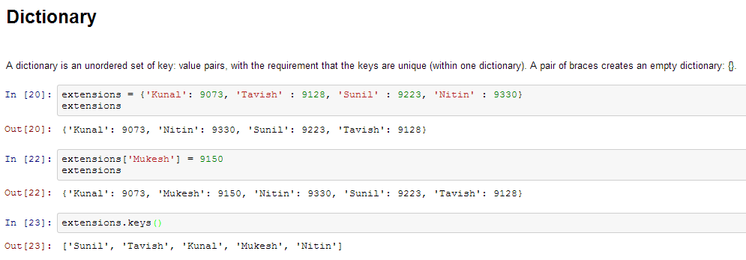
Data Structures: Dictionary
Dictionary is an unordered set of key: value pairs, with the requirement that the keys are unique (within one dictionary)
A pair of braces creates an empty dictionary: {}
Corporate Presentation Template | © 2016, Abzooba India Infotech Pvt. Ltd.

Slide 14

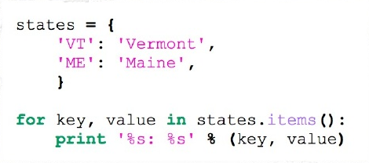
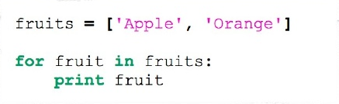
Python Iteration
Python also has a FOR-loop which is the most widely used method for iteration
Useful for replacing simple for-loops
Corporate Presentation Template | © 2016, Abzooba India Infotech Pvt. Ltd.

Slide 15
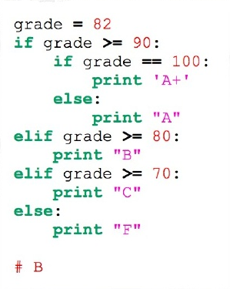
Conditional Constructs
Conditional statements are used to execute code fragments based on a condition
The most commonly used construct is if-else
Corporate Presentation Template | © 2016, Abzooba India Infotech Pvt. Ltd.

Slide 16
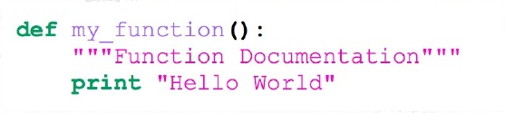
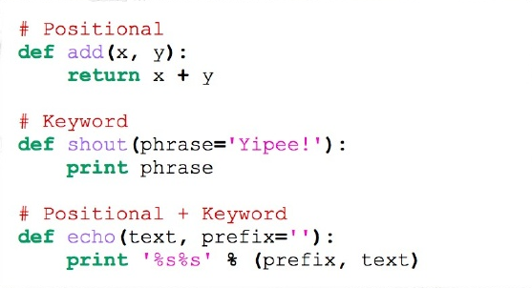
Functions
Functions make our code snippets reusable
Function arguments can be positional or keyword based
Corporate Presentation Template | © 2016, Abzooba India Infotech Pvt. Ltd.

Slide 17
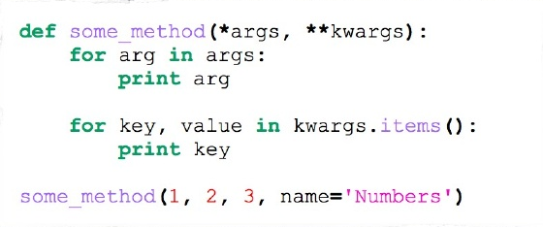
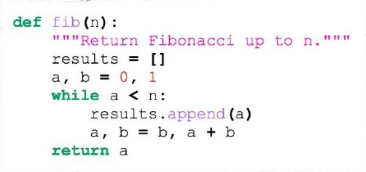
Functions (contd.)
Arbitrary arguments (or what we call varargs in Java)
The Fibonacci function
Corporate Presentation Template | © 2016, Abzooba India Infotech Pvt. Ltd.

Slide 18

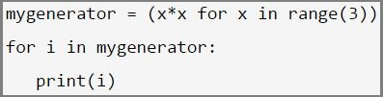
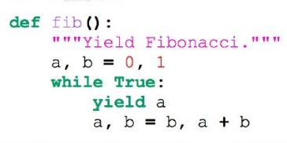
Python Generators
In a python list we can read its items one by one, and it’s called iteration. Hence a python list is iterable
Generators are iterators but you can only iterate over them once. It’s because they do not store all the values in memory, they generate the values on the fly
Use () in place of []
Yield is a keyword that is used like return, except the function will return a generator
You must understand that when you call the function, the code you have written in the function body does not run. The function only returns the generator object
Corporate Presentation Template | © 2016, Abzooba India Infotech Pvt. Ltd.

Slide 19


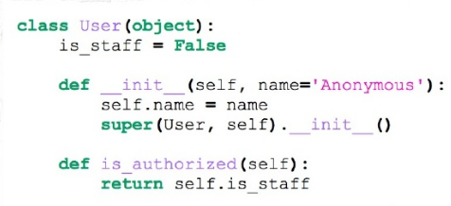
Classes
Class declaration
Class attributes
Class methods
Python does not have private attributes and functions
Special class methods start and end with double underscores
__init__, __doc__, __cmp__, __str__
Corporate Presentation Template | © 2016, Abzooba India Infotech Pvt. Ltd.

Slide 20
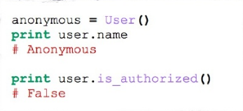

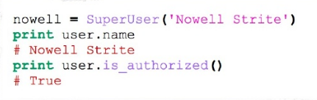
Classes (contd.)
Class instantiation and attribute access
Class inheritance
No interfaces
Corporate Presentation Template | © 2016, Abzooba India Infotech Pvt. Ltd.

Slide 21
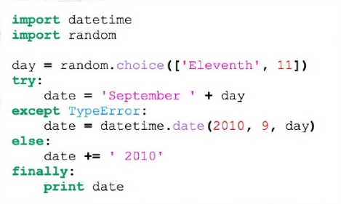
Error Handling
Using exceptions for flow control is common and normal
try-except-style is used to prevent the race-conditions inherent in some of the "look-before-you-leap" constructs
Always good practice to specify which kind of exception you want to catch
else-clause runs when there is no exception but before the finally-clause
finally will execute no matter what, even if another line is being evaluated with a return statement
Corporate Presentation Template | © 2016, Abzooba India Infotech Pvt. Ltd.

Slide 22
Python Libraries
Importing python libraries into our environment by defining an alias (we can now use various functions from math library (e.g. factorial) by referencing it using the alias m.factorial())
We can also import the entire name space e.g. in math we can directly use factorial() without referring to math
Tip: Google recommends that you use first style of importing libraries, as you will know where the functions have come from.
Allows code isolation and re-use
Corporate Presentation Template | © 2016, Abzooba India Infotech Pvt. Ltd.

Slide 23
List of Python Libraries
NumPy stands for Numerical Python. The most powerful feature of NumPy is n-dimensional array. This library also contains basic linear algebra functions, Fourier transforms, advanced random number capabilities and tools for integration with other low level languages like Fortran, C and C++
SciPy stands for Scientific Python. SciPy is built on NumPy. It is one of the most useful library for variety of high level science and engineering modules like discrete Fourier transform, Linear Algebra, Optimization and Sparse matrices.
Matplotlib for plotting vast variety of graphs, starting from histograms to line plots to heat plots.. You can use Pylab feature in ipython notebook (ipython notebook –pylab = inline) to use these plotting features inline. If you ignore the inline option, then pylab converts ipython environment to an environment, very similar to Matlab. You can also use Latex commands to add math to your plot.
Pandas for structured data operations and manipulations. It is extensively used for data munging and preparation. Pandas were added relatively recently to Python and have been instrumental in boosting Python’s usage in data scientist community.
Corporate Presentation Template | © 2016, Abzooba India Infotech Pvt. Ltd.

Slide 24
List of Python Libraries (contd.)
Scikit Learn for machine learning. Built on NumPy, SciPy and matplotlib, this library contains a lot of effiecient tools for machine learning and statistical modeling including classification, regression, clustering and dimensionality reduction.
Statsmodels for statistical modeling. Statsmodels is a Python module that allows users to explore data, estimate statistical models, and perform statistical tests. An extensive list of descriptive statistics, statistical tests, plotting functions, and result statistics are available for different types of data and each estimator.
Seaborn for statistical data visualization. Seaborn is a library for making attractive and informative statistical graphics in Python. It is based on matplotlib. Seaborn aims to make visualization a central part of exploring and understanding data.
Bokeh for creating interactive plots, dashboards and data applications on modern web-browsers. It empowers the user to generate elegant and concise graphics in the style of D3.js. Moreover, it has the capability of high-performance interactivity over very large or streaming datasets.
Corporate Presentation Template | © 2016, Abzooba India Infotech Pvt. Ltd.

Slide 25
List of Python Libraries (contd.)
Blaze for extending the capability of Numpy and Pandas to distributed and streaming datasets. It can be used to access data from a multitude of sources including Bcolz, MongoDB, SQLAlchemy, Apache Spark, PyTables, etc. Together with Bokeh, Blaze can act as a very powerful tool for creating effective visualizations and dashboards on huge chunks of data.
Scrapy for web crawling. It is a very useful framework for getting specific patterns of data. It has the capability to start at a website home url and then dig through web-pages within the website to gather information.
SymPy for symbolic computation. It has wide-ranging capabilities from basic symbolic arithmetic to calculus, algebra, discrete mathematics and quantum physics. Another useful feature is the capability of formatting the result of the computations as LaTeX code.
Requests for accessing the web. It works similar to the the standard python library urllib2 but is much easier to code. You will find subtle differences with urllib2 but for beginners, Requests might be more convenient.
Corporate Presentation Template | © 2016, Abzooba India Infotech Pvt. Ltd.

Slide 26
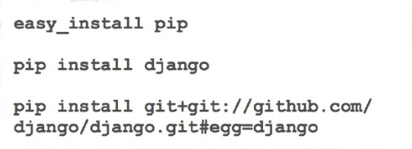

Library/Package Management
pip is a package management system used to install and manage software packages written in Python.
Python Virtual Environments allow Python packages to be installed in an isolated location for a particular application, rather than being installed globally. Virtual Environments have their own installation directories and they don’t share libraries with other virtual environments
Virtualenv is one of the tools for creating Python virtual environments
Corporate Presentation Template | © 2016, Abzooba India Infotech Pvt. Ltd.

Slide 27
Resources
https://www.python.org/downloads/ - Python
https://www.continuum.io/downloads - Anaconda
https://automatetheboringstuff.com/#toc – Fun book on Python Programming
Corporate Presentation Template | © 2016, Abzooba India Infotech Pvt. Ltd.

Slide 28
Thank You
www.aidemy.org | support@aidemy.org
Corporate Presentation Template | © 2016, Abzooba India Infotech Pvt. Ltd.

